Slide 1
How to Predict Business Success & Failure
Unveiling the Power of Data Science in Predicting Business Success
-Guntaas Kaur

Slide 2
WHY?
Understanding the Reasons Behind Small Business Failures and Leveraging Machine Learning for Enhanced Success

Slide 3
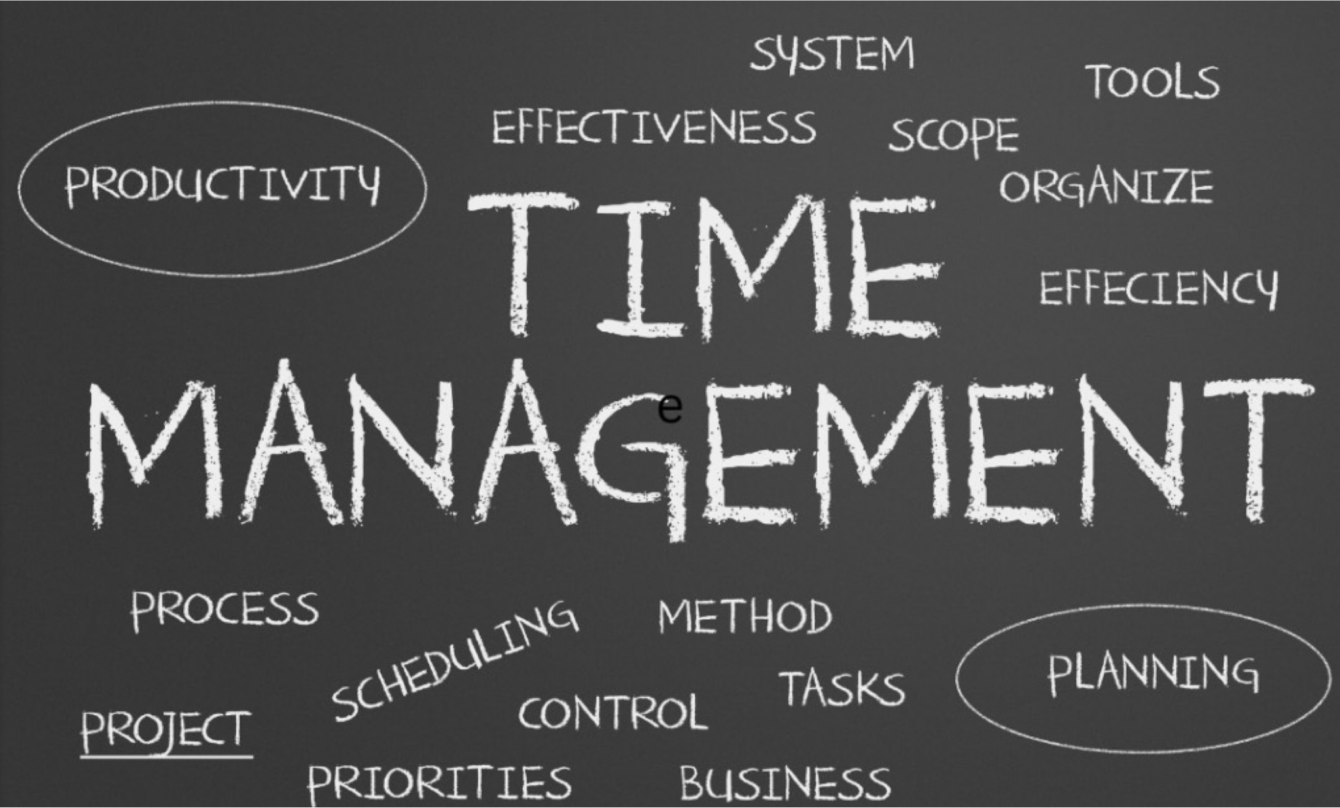

Slide 4
So, the big question we're asking here is:
Can we figure out if a business will keep going or not?
And what are the main features that tell us if it will?

Slide 5

About dataset
Yelp is a popular platform and mobile app founded in 2004 that connects people with local businesses. It allows users to discover and review businesses such as restaurants, bars, cafes, shops, salons, and more. Yelp provides a platform for consumers to share their experiences and opinions through reviews, ratings, photos, helping others make informed decisions about where to eat, shop, or visit.

Slide 6
Dataset Description
Reviews: There are 6,990,280 reviews in the dataset.
Businesses: The dataset includes information on 150,346 businesses.
Pictures: There are 200,100 pictures included in the dataset.
Metropolitan Areas: The dataset covers 11 metropolitan areas.
Tips: Users have provided 908,915 tips in total.
Users: The dataset includes tips from 1,987,897 unique users.
Business Attributes: There are over 1.2 million business attributes available in the dataset.
Check-ins: The dataset includes aggregated check-in data over time for each of the 131,930 businesses listed.

Slide 7
Data Dictionary
Business ID: Unique identifier for each business. Name: Name of the business. Address: Address of the business. City: The city where the business is located. State: State where the business is located. Postal Code: Postal code of the business. Latitude: Latitude coordinates of the business location. Longitude: Longitude coordinate of the business location. Stars: Average rating of the business. Review Count: Number of reviews the business has received. Is Open: Indicates if the business is currently open (1 for open, 0 for closed). Attributes: Additional attributes or features of the business. Categories: Categories or types of services offered by the business. Hours: Operating hours of the business.

Slide 8
Reviews:
Review ID: Unique identifier for each review. User ID: Unique identifier for the user who wrote the review. Business ID: Unique identifier for the business being reviewed. Stars: Rating given by the user (1 to 5 stars). Text: The text content of the review. Date: The date when the review was written.

Slide 9
Users:
User ID: Unique identifier for each user. Name: User's name. Review Count: Number of reviews written by the user. Average Stars: Average rating given by the user. Yelper Since: Date when the user joined Yelp.
Tips:
User ID: Unique identifier for the user who wrote the tip. Business ID: Unique identifier for the business the tip is about. Text: The text content of the tip. Date: The date when the tip was written.

Slide 10
Data Preprocessing
Flattening Nested Structures:
The dataset contains nested dictionaries and JSON-like structures, had to flatten them into string representations to create flat feature vectors suitable for modeling.
"hours": {
"Monday": "10:00-21:00", "Tuesday": "10:00-21:00", "Friday": "10:00-21:00",
"Wednesday": "10:00-21:00", "Thursday": "10:00-21:00", "Sunday": "11:00-18:00",
"Saturday": "10:00-21:00"
}

Slide 11
Handling missing values
categories 103 day 23223
attribute_name 15281 attribute_value 15281
start_time 23223 end_time 23223
The percentage of null for categories is much smaller. For the <3% missing columns we can take any reasonable approach. For the day, attribute_name, attribute_value, start_time and end_time columns it may be worth imputing these values as dropping 15.44% and 9.14% of rows may be too much data loss.

Slide 12
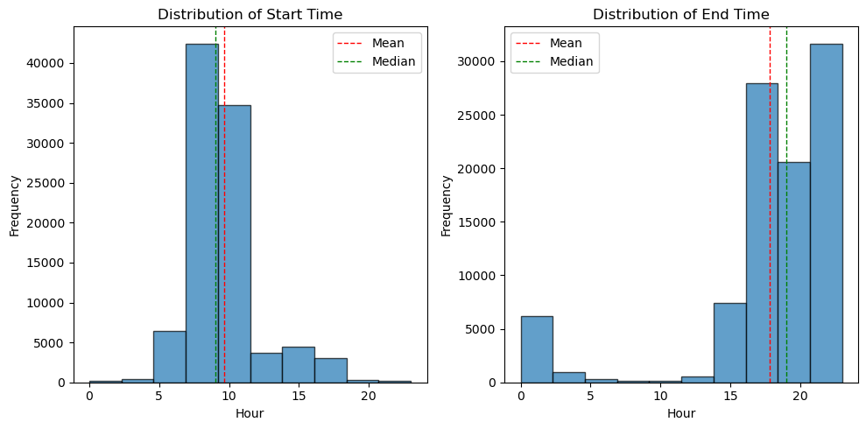

Slide 13
Future
Model Selection: Choosing appropriate machine learning models based on the nature of the problem, the structure of the data, and the desired outcome. Consideration may include decision trees, random forests, support vector machines, or deep learning models.
Model Training: Training the selected models on the preprocessed data using appropriate training techniques such as cross-validation. Tune hyperparameters to optimize model performance.
Model Evaluation: Evaluating the trained models using performance metrics such as accuracy, precision, recall, F1-score, or area under the ROC curve (AUC). Compare the performance of different models to select the best-performing one.
Model Deployment: Deploying the trained model to make predictions on new data. This could involve integrating the model into an application, creating APIs for real-time predictions, or deploying it on a cloud platform.
Monitoring and Maintenance: Continuously monitor the deployed model's performance and update it as needed. This may involve retraining the model with new data, adjusting parameters, or addressing drift in the data distribution

Slide 14
Thank you!!

